Slide 1

AI-Powered Recipe Recommendation System
Smart Cooking Assistant using Web Technologies & NLP
S.NIVETHA
II MCA
RA243224140034

Slide 2
Abstract
This project introduces an AI-powered recipe recommendation system designed individuals often struggle to decide what to cook based on the ingredients available, dietary preferences, or limited time. This project aims to solve that problem by creating an AI-powered recipe recommendation web application that intelligently suggests recipes based on user inputs such as diet type, available ingredients or cravings, and preparation time.
The system leverages Natural Language Processing (NLP) techniques to interpret descriptive user queries like “spicy paneer” or “crispy dosa”, even if the input isn’t structured or exact. By analyzing keywords from user input and comparing them with a structured recipe dataset, the application delivers smart, relevant, and user-friendly recipe suggestions.
The project is developed using a Flask-based Python backend, integrated with HTML, CSS, and JavaScript for a responsive, interactive front-end. Key features include AI-based ingredient matching, prep time filtering, diet-based sorting, dark mode support, favorite saving option, and modal pop-ups that display full recipe details when clicked.
This project not only simplifies meal planning for users but also enhances the overall experience through an engaging UI and intelligent filtering — making it a practical and innovative solution in the space of digital cooking assistants.

Slide 3
Existing System
Manual searching on recipe websites
Lack of personalization or AI-based filtering
No ingredient-specific or dietary-specific matching
Overwhelming interfaces with ads/popups
No smart filters or time-based recipe suggestions

Slide 4
Problem Identification & Proposed System
Problems Identified:
Users don’t get relevant recipes quickly:
On traditional websites or apps, users often scroll through long lists of recipes.
If they type "spicy egg curry with low oil", the search may not return accurate results.
There's no smart understanding of what the user is really craving or needing — it’s keyword-based, not meaning-based.
No intelligent understanding of ingredient combinations:
Users may type natural, casual phrases like "cheesy pasta without garlic" or "healthy paneer dinner".
Most existing systems can't break down and understand such input.
They treat all words as simple text and don’t use NLP to match recipes based on meaning or ingredient intent.
No support for dietary needs or limited cooking time:
People often have specific needs:
Vegetarian, low-calorie, gluten-free, less than 20 minutes prep.
Most platforms don’t support multi-criteria filters like diet + time + ingredient.
This forces users to manually check each recipe, wasting time.

Slide 5
Proposed System Highlights:
AI matches recipes based on user's ingredients & cravings:
The system uses Natural Language Processing (NLP) to understand casual input like "spicy mushroom dish" or "quick paneer snack".
Based on that, it filters recipes that closely match the meaning behind the user’s request — not just exact words.
This gives smarter, more relevant recipe suggestions.
Filters for diet type (Vegetarian / Non-Vegetarian):
Users can choose dietary preferences.
This ensures the system only shows recipes suitable for that preference — a must-have feature for many people.
Prevents users from having to open and read every recipe to check for ingredients.
Prep time filter to suggest quick meals:
Users can input the maximum time they can spend cooking (e.g., 15 or 30 minutes).
The system shows only those recipes that meet the time limit.
Ideal for busy students or working individuals who want fast meals.
Dark mode, recipe popup modal, and favorites.
Data-driven recommendation using CSV dataset.
Calculate the calories

Slide 6
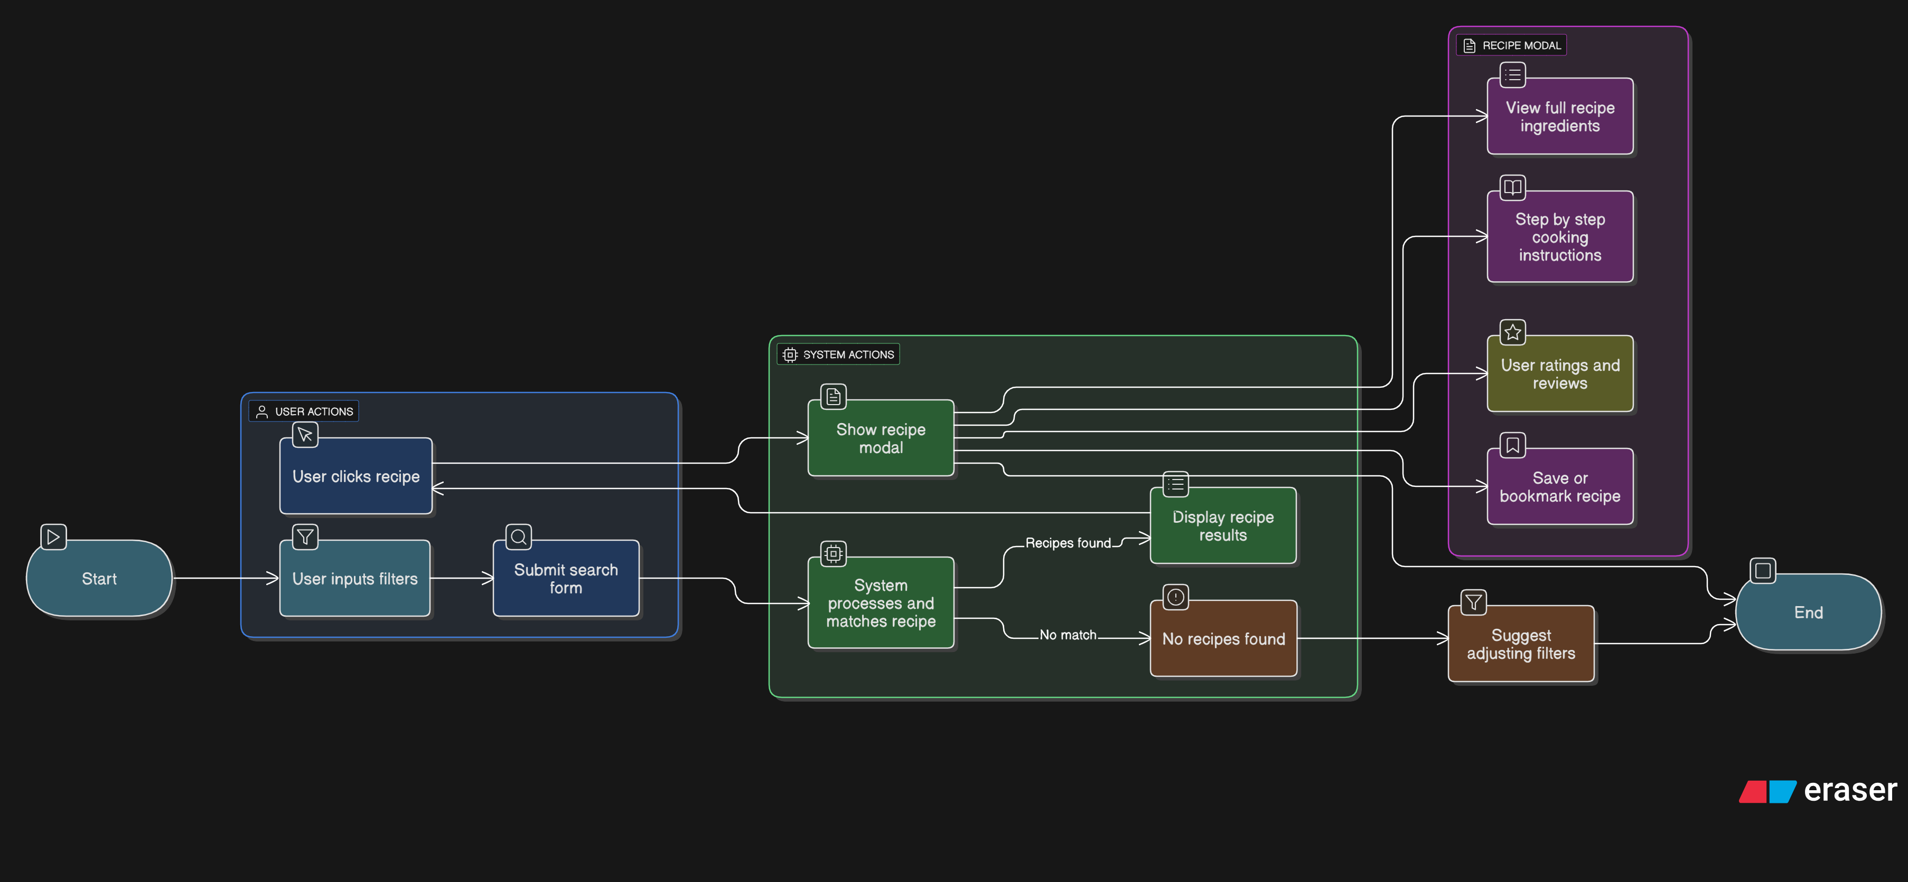
Activity diagram

Slide 7
Summary
An intelligent, responsive recipe search platform
Uses real-time filtering from CSV data
Offers AI-based user interaction using simple NLP matching
Improves user cooking experience with clear UI, recipe previews, and customization
Easily extendable with ML, chatbot, voice input, or backend database

Slide 8
Thank You

